Slide 1



School Management System

Slide 2

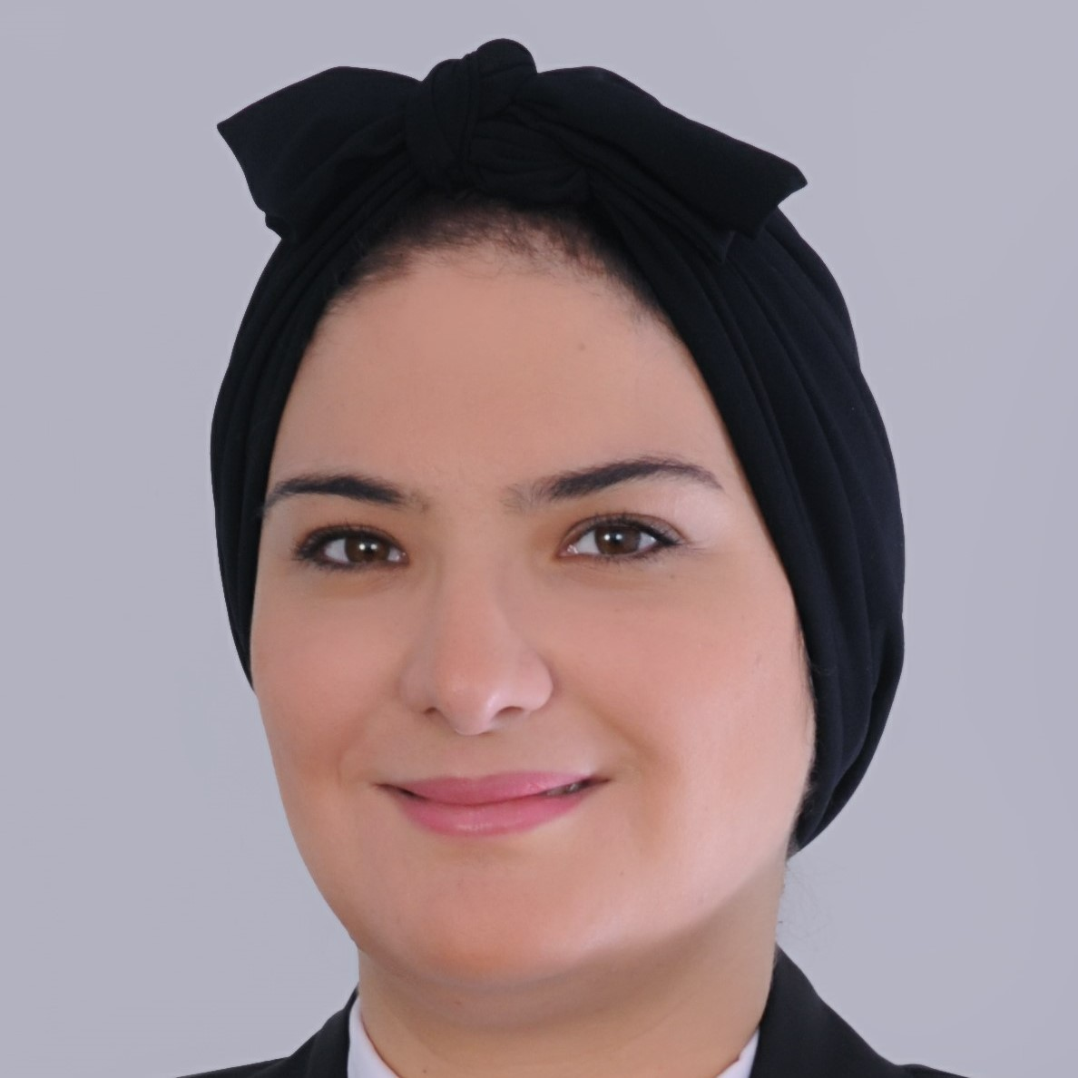
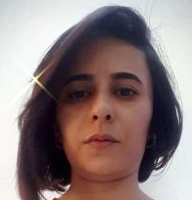
1-Team
Soumaya Cherichi
Najwa Elfahem

Slide 3

2-Context
As part of the validation of our Full Stack Python

Slide 4
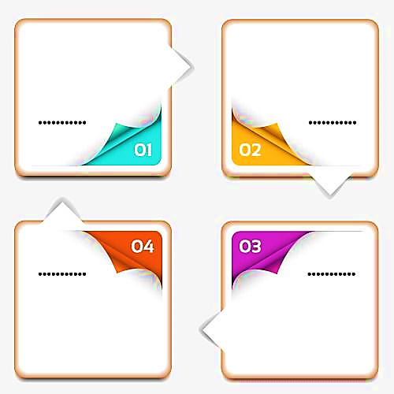

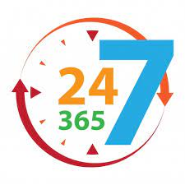


3-Needs
Non-continious follow-up between parents and teachers
The availability of parents does not match that of teachers
Increase of uncompleted home works
Lack of time

Slide 5




4- Solutions
Construction of a plateform that includes the learning and administration part
Involvement of all members of the school for the success of the child
Use of affordable technology for parents and the school members
Exploitation of data to represent a dashboard for school member and parents

Slide 6
5- Logical architecture
Admin
Parent
Teacher
Student

Slide 7

5- Logical architecture
As Admin
Manage
Parents
Manage
Students
Manage
Teachers
Manage
Classes
Manage
Notifications

Slide 8
5- Logical architecture
As teacher
Manage
Courses
Manage
Home_
works
Manage
Marks
Consult
Notif
Send Message

Slide 9
5- Logical architecture
As parent
Consult
Home
Work
Upload
Home
Work
Consult /
response
Notif
Consult/
response
Message
Update
Profil

Slide 10
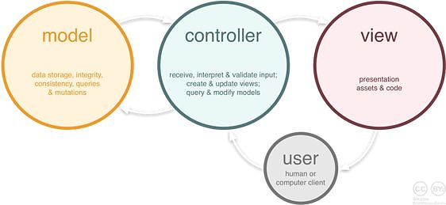


6- Technical architecture

Slide 11










7-Tools and technology

Slide 12
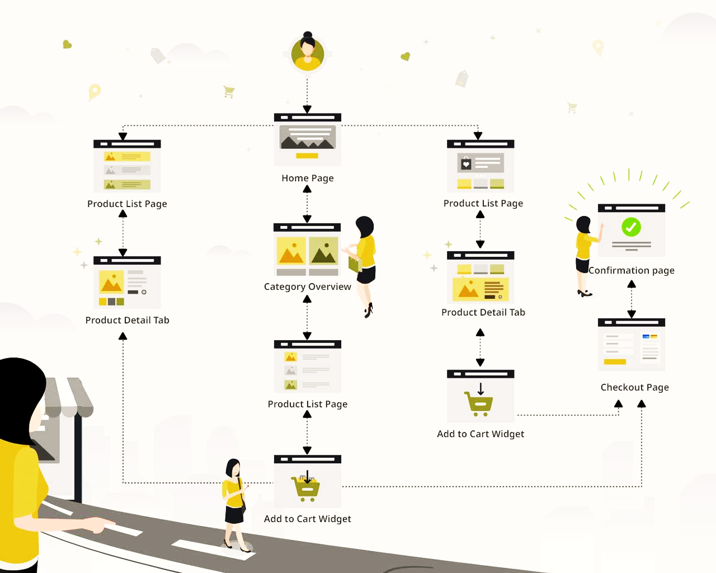
8-User Journey
Login page
Access page
Message page
Profile page
Notification page
Response page
Notifications
Download
Download files

Slide 13
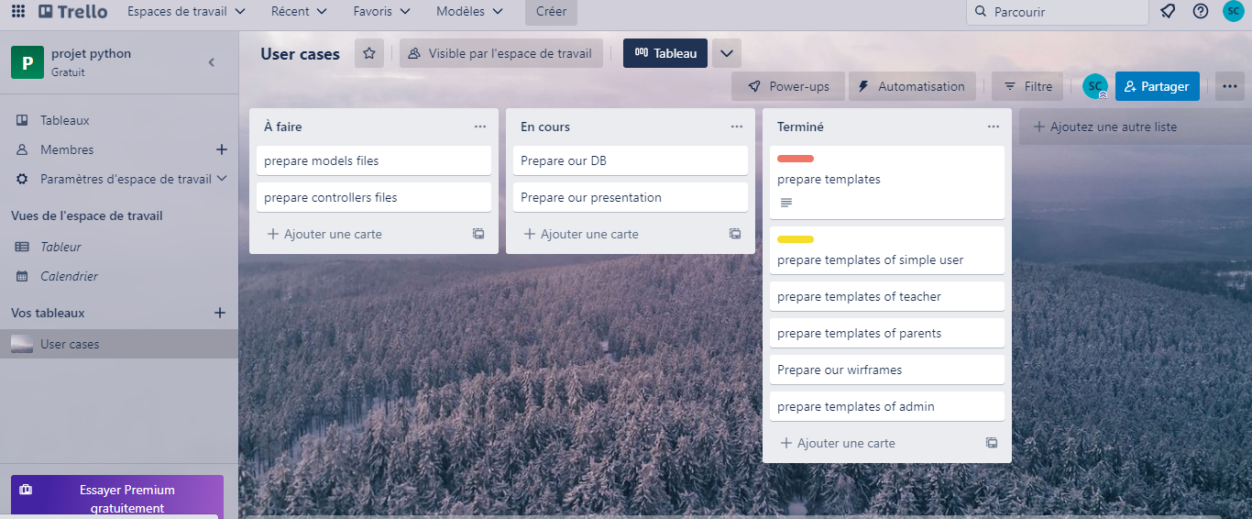

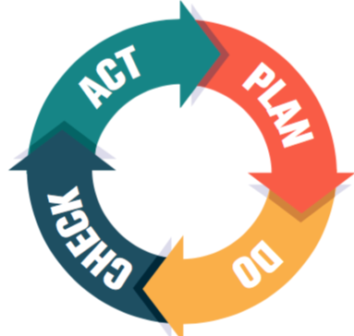
9-Methogology

Slide 14


10-Challenges
Manage our one-to-ones with our instructor to be more productif
Prepare 4 different types of templates for each user
Manage our schedule between our family our work and our bootcamp

Slide 15
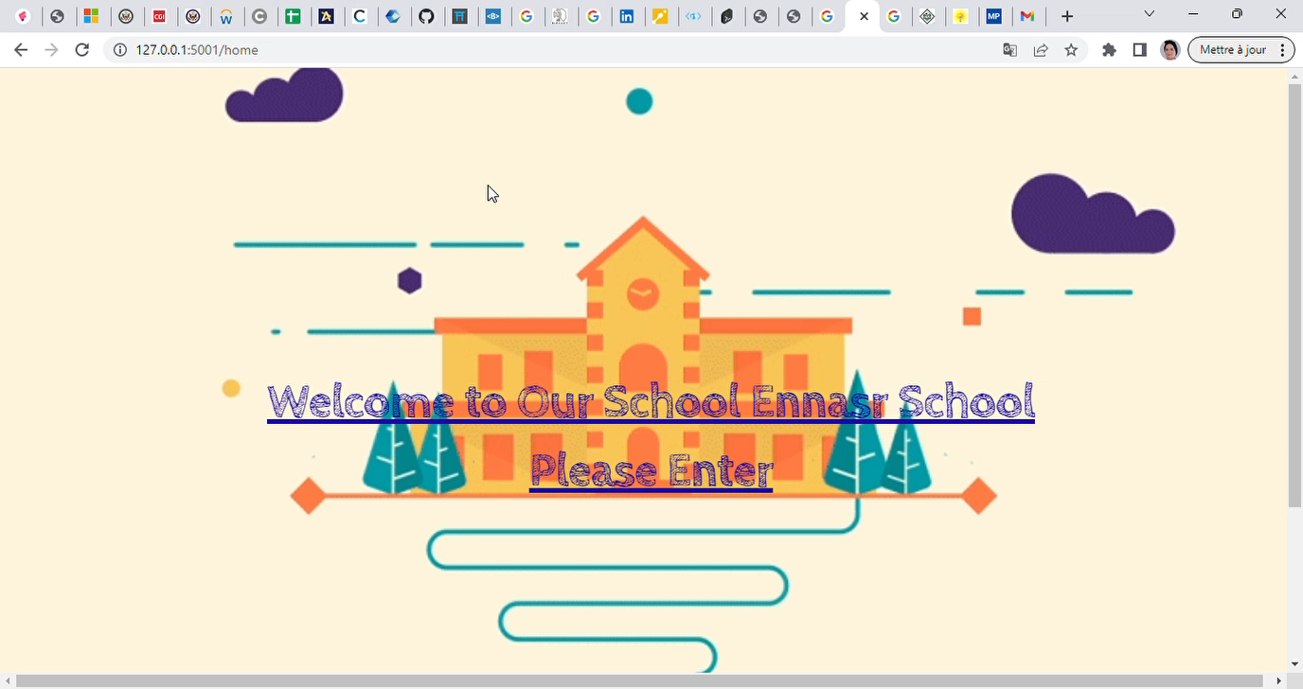
11- Video Recording

Slide 16
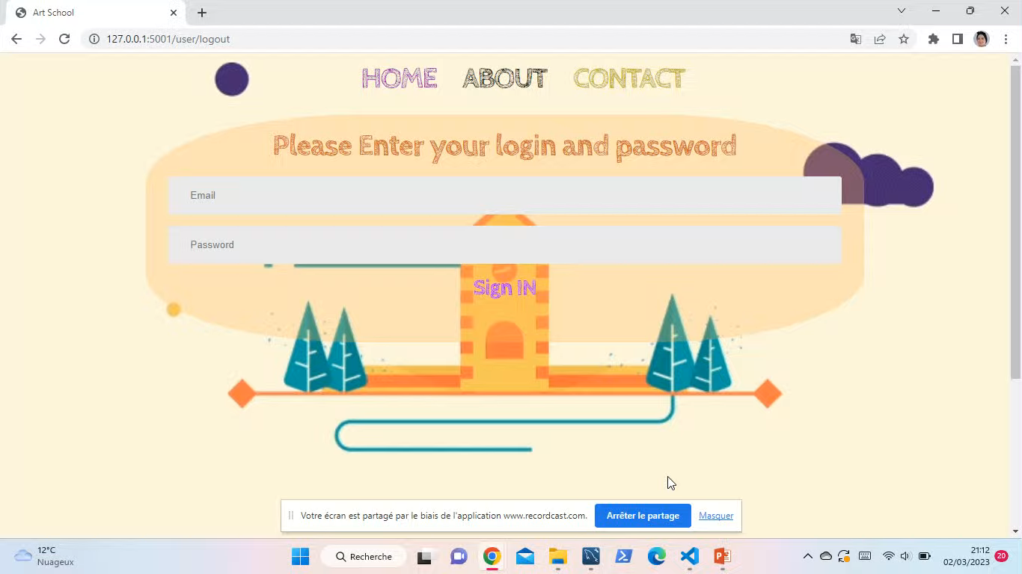
11- Video Recording

Slide 17
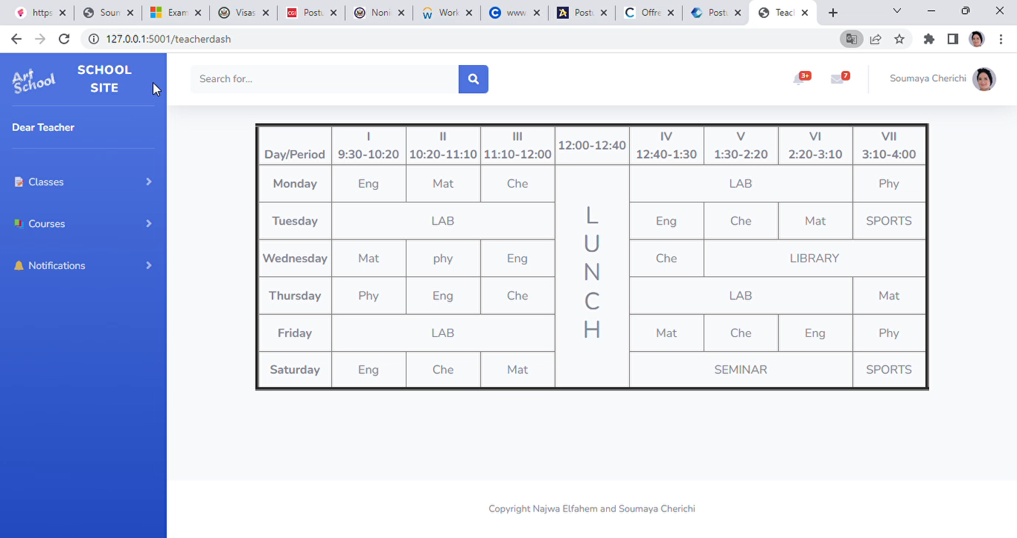
11- Video Recording

Slide 19


12-Roadmap
Deployment of our application
Integrate a new module for disabled person
Integrate a new module for online homework and automatic correction,

Slide 20

Thank you for attention

